Slide 1
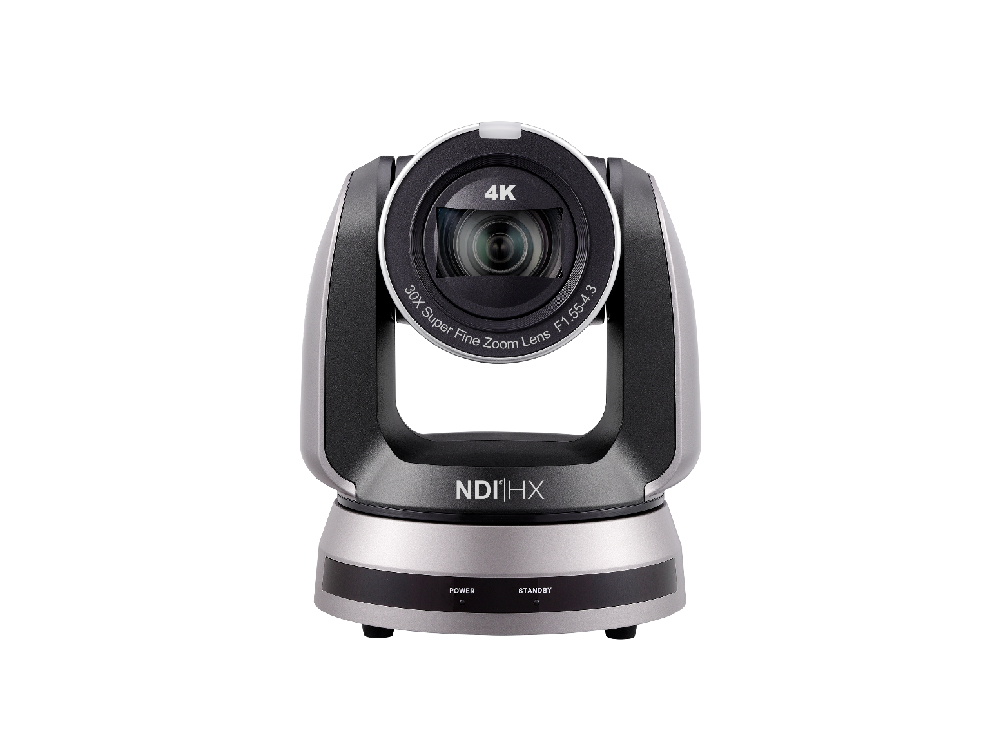
VC-A71SN
4K NDI® PTZ Camera
with NDI®|HX3 and 12G-SDI
Product Introduction
Notes:
Let’s see the new product introduction. 4K NDI PTZ Camera, VC-A71SN

Slide 2




Overview
VC-A71SN
4K NDI® PTZ Camera
with NDI®|HX3 and 12G-SDI
Color: Black, White
NDAA/TAA Compliant: Yes
Warranty: 5-Year
MAP: $4,495
Notes:
VC-A71SN is a 4K NDI PTZ Camera, with NDI HX3 and 12G-SDI.
The color is available for black and white.
It is NDAA and TAA Compliant. and it comes with 5-year warranty.

Slide 3
Product I/O
VC-A71SN Front View
Lens
Pan Tilt Robotics
IR Receiver
Status LED
Notes:
It has the smooth pan tilt, IR receiver, and status LED.

Slide 4
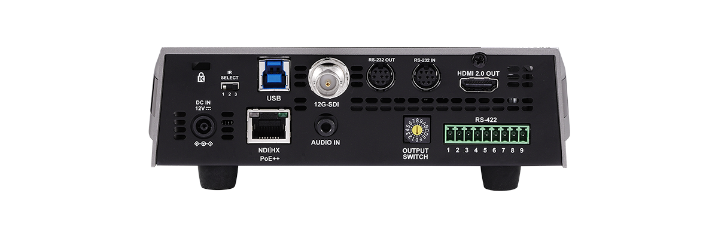
Product I/O
VC-A71SN Back View
RS-232 Output
USB 3.0
12G-SDI
Output
RS-232 Input
IR Select
Kensington Lock
HDMI
DC 12V Input
RS-422
Output Switch
Audio In
NDI|HX
PoE++
Notes:
On the back, we have DC 12V input, Kensington lock port, IR Select ID, USB 3, 12-SDI port, RS232, HDMI, RS-422 port, Output Switch, Audio input, And Ethernet port.

Slide 5




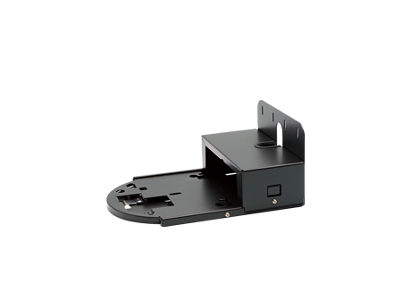

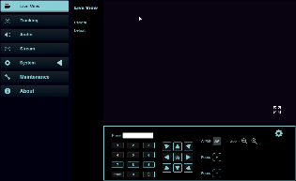
Accessories & Software
Software
Deployment Tool
2.0
Camera Controller
CamConnect
Virtual Camera
Accessories
Control
Wall mount
WM12
Remote Controller
Webpage
Notes:
You can use Lumens software Deployment tool 2, Camera Controller, CamConnect and Virtual Camera with VC-A71SN.
If you need to ceil the camera, you can use WM12 PTZ Wall mount. and use remote or webpage to control.

Slide 6
Key Features
4K 60 fps, 30x optical zoom, 1/1.8” Sensor
12G-SDI, HDMI, Ethernet, USB3.0 output
Supports NDI|HX3 / NDI|HX2 / RTSP / RTMP / RTMPS / MPEG-TS / SRT
Supports FreeD protocol for live VR/AR production
BT.2020 / Rec.709 color space support
Notes:
Here are some key features of VC A71SN.
With 4K 60 frame and 30x optical zoom,
With 12G-SDI, HDMI, Ethernet, USB 3 output
Supports NDI|HX3 and HX2 , RTSP , RTMP , RTMPS , MPEG-TS , SRT
Supports FreeD protocol for live VR,AR production
BT 2020 / Rec 709 color space support

Slide 7

Selling Point
Rec.709
BT.2020
NDI®|HX3 Technology
12G-SDI
BT.2020/Rec.709
VC-A71SN supports the latest version of the NDI protocol, NDI®|HX3. It delivers very high quality video with ultra-low latency and connects directly to NDI® networks.
Lumens VC-A71SN is equipped with a 12G-SDI video output.
This port delivers UltraHD at up to 60 frames a second, meaning it can capture fast motion and deliver smooth video output.
Lumens® VC-A71SN supports the BT.2020 color gamut for wide and precise color reproduction.
With BT.2020, VC-A71SN will be easy to match other cameras and deliver video output optimized for new generation UltraHD monitors.
Notes:
VC-A71SN supports the latest version of the NDI protocol, NDI HX3. It delivers very high quality video with ultra-low latency and connects directly to NDI networks.
It is equipped with an 12G SDI video output. This port delivers UltraHD at up-to 60 frames a second, meaning it can capture fast motion and deliver smooth video output.
It supports the BT 2020 color gamut for wide and precise color reproduction.
With BT 2020, VC A71SN will be easy to match other cameras and deliver video output optimized for new generation UltraHD monitors.

Slide 8

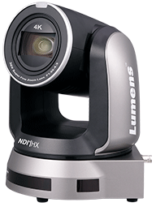
Selling Point
Live VR/AR Video Production
Smooth PTZ Movement
VC-A71SN supports the FreeD protocol. This enables users to work with Virtual Reality and Augmented Reality sets without the need for additional sensors.
With high-precision motor control and Lumens’ innovative mechanical transmission mechanism, VC-A71SN achieves smooth, high-speed movement without any judder. The speed of movement is fully customizable.
Notes:
VC A71SN supports the Free D protocol. This enables users to work with Virtual Reality and Augmented Reality sets without the need for additional sensors.
With high-precision motor control and Lumens’ innovative mechanical transmission mechanism, VC-A71SN achieves smooth, high-speed movement without any judder. The speed of movement is fully customizable.

Slide 9

New VS Old
 | VC-A71SN | VC-A71PN
Sensor | 1/1.8" 9.17 MP CMOS
Video Output | 4Kp60
Video Output(HD) Interface | 12G-SDI, HDMI2.0, Ethernet, USB3.0 | HDMI 2.0,Ethernet
Optical Zoom | 30x
Horizontal Viewing Angle | 63°
AR/VR systems | FreeD
PoE | POE++ (IEEE802.3bt) | POE+ (IEEE802.3at)
Video Stream Protocol | NDI|HX3 / NDI|HX2 / RTSP / RTMP / RTMPS / MPEG-TS / SRT | NDI|HX2 / RTSP / RTMP / RTMPS / MPEG-TS / SRT
Camera Control Interface | RS-232 / RS-422 / Ethernet / USB 3.0 | RS-232 / RS-422 / Ethernet
Camera Control Protocol | VISCA / VISCAIP / PELCO D / ONVIF / NDI / UVC | VISCA / VISCAIP / PELCO D / NDI / ONVIF
USB Video Format | 2160P30 | NA
Audio Input | Line In / MIC In
Audio Output | Ethernet / 12G-SDI / HDMI / USB | Ethernet / HDMI
Notes:
VC A71SN is the next generation product of VC A71PN, it supports 12G-SDI, USB3, NDI HX3 more than VC A71PN.

Slide 10
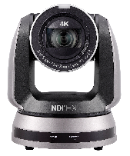
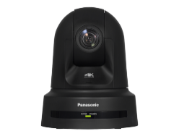
Competition
Item | Model Name | Lumens VC-A71SN | Panasonic AW-UE80
Camera | Price(USD) | $ 4,495 | $ 5,500
 | Video Format | 4K60p | 4K60p
 | Sensor | 1/1.8" 9.17 MP CMOS | 1/2.5" MOS
 | Video Output Interface | 12G-SDI, HDMI2.0, Ethernet, USB3.0 | 3G-SDI, HDMI, Ethernet
 | Optical Zoom | 30x | 24x
 | Horizontal Viewing Angle | 63° | 74.1°
 | Focal Length | 6.5mm ~ 202mm | 4.12 ~ 98.9 mm
 | Minimum Object Distance | 1.5m (Wide/Tele) | 100 mm(Wide) 1200 mm(Tele)
 | Focus System | Auto, Manual, Smart AF | Auto, Manual
 | Genlock | NA | Yes
 | Image Stabilization | NA | OIS
 | AR/VR systems | FreeD | FreeD
Pan & Tilt | Motor Type | Stepping | Direct Drive
Output | HDMI/SDI | HDMI : 4Kp60 12G-SDI : 4Kp60 | HDMI : 4Kp60 3G-SDI : 1080p60
 | IP Stream | HEVC 4Kp60 H.264 1080p60 H.264 360p30 | HEVC 1080p60
 | USB Output | H.264 2160p30fps MJPEG 1080p30 | NA
Network | Stream Protocol | RTSP / RTMP / RTMPS / MPEG-TS / SRT / NDI|HX3 | RTSP / RTMP / MPEG-TS / SRT / NDI|HX / HB NDI
Camera Control | Protocol | VISCA / PELCO D / NDI|HX / UVC / ONVIF | Panasonic / NDI
 | UVC | Yes | NA
 | UAC | Yes | NA
Notes:
Compare with Panasonic AW-UE80, Lumens VC-A71SN has 12G SDI and USB output, and supports the latest version of the NDI protocol, NDI HX3

Slide 11
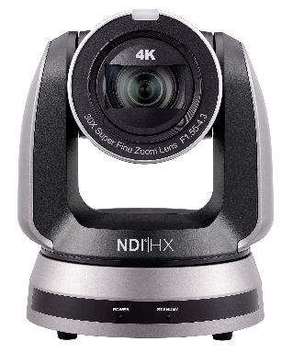

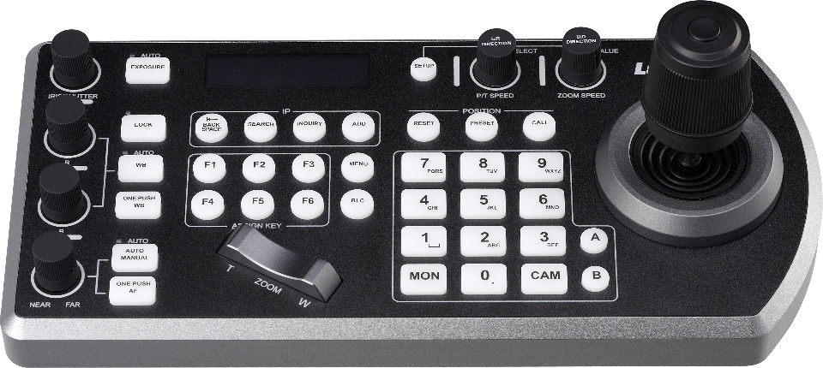
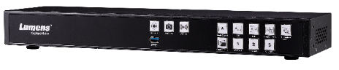
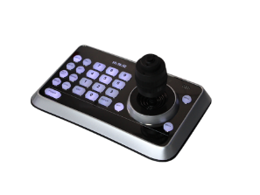
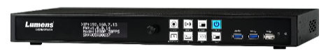
Integration
Lumens Product
VS-KB30
LC200
VS-K20
LC100
Control
Media Processor
Notes:
VC-A71SN can be used with VS-KB30 or KB20 to control, or you can use LC200 or LC100 to record or do the live streaming.

Slide 12
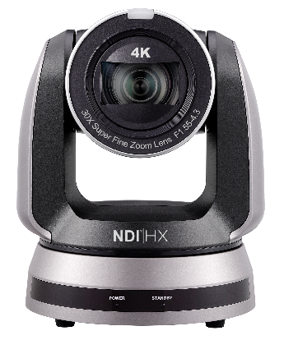












Integration
Third-Party
Stream Deck
Streaming Platform
Broadcasting Software
Notes:
It can also integrate with Third-party products like stream deck or you can stream to different platforms or use with Broadcasting Software.

